Slide 1

Applied Cyber Infrastructure Concepts Fall 2017
Will Computers Crash Genomics? Science Vol 331 Feb 2011
Nirav Merchant (nirav@email.arizona.edu)
CyVerse & Bio Computing
Eric Lyons (ericlyons@email.arizona.edu) CyVerse & Plant Sciences University of Arizona
1

Slide 2
Tasks for today
Importance of Web API (REST)
Key Concepts for interacting with REST
Hands on with iNaturalist API
Homework with API

Slide 3
Web API
API: Application Programming Interface
Calling API over the web (http/https)
So why do you want to call API over the web ?
Data size
Data Complexity
Linked data
Specialized databases and data structure
It allows for automation (mashup, workflows, webhooks)

Slide 4
Where do you find web API’s
Most service providers (data, compute, information)
Why do they provide API access ?
How do you interact with their API ?
https://github.com/toddmotto/public-apis

Slide 5
RESTful Services
RESTful (Representational State Transfer)
RESTful web services is a way of providing interoperability between computer systems on the Internet
Architectural Styles and the Design of Network-based Software Architectures Fielding, Roy Thomas (2000) Doctoral dissertation, University of California, Irvine
Connects web resources (url) using operations like
GET
POST
PUT
DELETE

Slide 6
Key Concepts to get started
HTTP(s)
URL/URI
Protocols
Authentication
JSON
Parsing content
Tools to have
JSON viewer for your browser
curl
JSON formatter for command line

Slide 7
Web Communication
HTTP(s)
URL/URI
https://zapier.com/learn/apis/chapter-2-protocols/

Slide 8
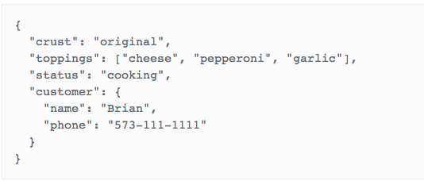
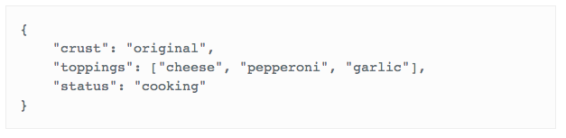
JSON
https://gist.github.com/benbalter/3952577 https://zapier.com/learn/apis/chapter-3-data-formats/
JSON is a very simple format that has two pieces: keys and values.
Keys represent an attribute about the object being described

Slide 9
How all of this comes together
iNaturalist website
Let’s read the documentation they have provided
http://api.inaturalist.org/v1/docs/
Why is there a v1 ?
Lets explore some of the API and test it with real data
Take the curl suggestion and try it out on command line
Try with Observation and Place ID
Place ID: 95816
Observation ID: 6587741,8231742
https://wiki.cyverse.org/wiki/display/AC/iNaturalist+API

Slide 10
Homework
Find a provider that supports REST API and has good documentation
Test one of the API with your input and post a screenshot of output
Due Oct 5 2017

